Slide 1
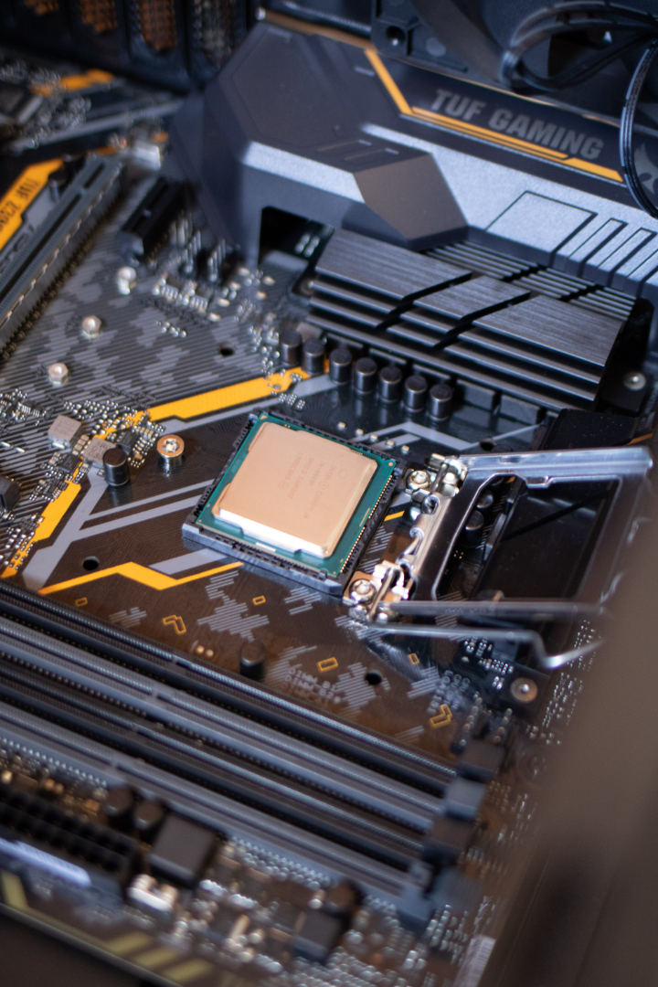
Introduction to Throughput Measurement
Throughput measurement is a critical aspect of evaluating the speed and efficiency of processing catalogs. It involves assessing the capacity of the process to handle a specific amount of work within a given period. Through this comprehensive measurement process, organizations can gain valuable insights into the effectiveness of their catalog processing systems.

Slide 2
Importance of Measuring Speed and Efficiency in Processing Catalogs
Enhanced Productivity
Customer Satisfaction
Resource Optimization
Measuring the speed and efficiency of processing catalogs is crucial for enhancing overall productivity. It allows organizations to identify and address bottlenecks, ensuring smoother operations.
Efficient catalog processing directly impacts customer satisfaction. Faster processes ensure timely updates and accurate information, leading to improved customer experience.
Measuring speed and efficiency helps in optimizing resources by identifying areas where improvements can be made, leading to cost savings and better resource allocation.

Slide 3
Test Case: In-depth Measurement of Solution's Speed and Efficiency
1
Scope Definition
Defining the scope of the test case is critical, outlining the specific processes, parameters, and systems that will be evaluated for speed and efficiency.
2
Data Collection & Preparation
Gathering relevant data and preparing it for the test case is essential. This involves ensuring that the right metrics and parameters are selected for accurate measurement.
3
Execution & Monitoring
The test case is executed while closely monitoring the speed and efficiency of the solution in processing catalogs, recording all relevant data and observations.

Slide 4
Methodology for Conducting the Test Case
1
Data Sampling
2
Control Group Definition
3
Measurement Tools Selection
Identifying the appropriate sample size and type of data to be tested.
Establishing a control group for benchmarking and comparison purposes.
Choosing the right tools to accurately measure the processing speed and efficiency of catalogs.

Slide 5

Key Metrics and Parameters for Measurement
Processing Speed
The time taken to process and update data within the catalogs.
Accuracy Rate
The level of accuracy in the processed catalog data compared to the source.
Resource Utilization
The efficiency of resource utilization during the catalog processing activities.

Slide 6



Analysis of the Test Results and Insights Gained
Data Comparison
Trend Analysis
Insight Generation
Comparing the test results with the expected benchmarks and industry standards.
Identifying patterns and trends in the data to understand performance variations.
Extracting valuable insights and actionable recommendations from the test results.

Slide 7
Recommendations for Improving Throughput and Efficiency
1
Process Optimization
2
Technology Upgrade
3
Training & Development
Implementing process improvements based on the test findings to enhance speed and efficiency.
Considering technology upgrades or enhancements to streamline catalog processing activities.
Investing in employee training and development to optimize catalog processing skills and knowledge.

Slide 8
Conclusion and Key Takeaways
6
85%
Optimization Opportunities
Accuracy Improvement
Identified opportunities for process optimization to enhance throughput.
Significant potential for improving the accuracy of catalog processing.

